Slide 1
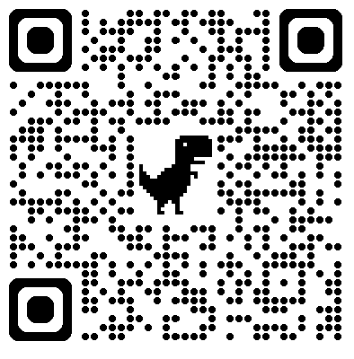
Are We Doing What We Say We’re Doing?
Assessing the Constructive Distributed Work model for sustainable research teams
Shelton Weech, Michelle McMullin, Dilara Avci, Wei Xu, Hadi Banat
SIGDOC 2024
Notes:
Hello, and welcome to our presentation! Today we’re assessing the Constructive Distributed Work model for sustainable research teams.

Slide 2
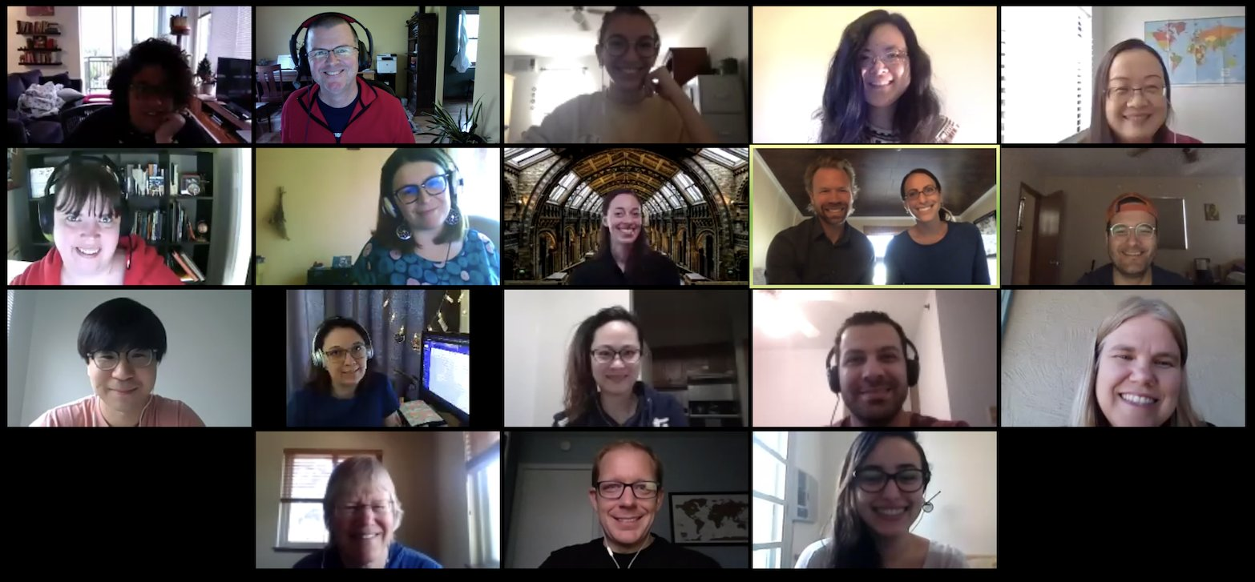
Corpus and Repository of Writing (Crow)
We are:
Interinstitutional
Interdisciplinary
Focused on inclusive, ethical and respicoral spaces for research teams
Notes:
Our team includes researchers from nearly a dozen institutions spanning specialities including linguistics, writing studies, second language studies, and technical communication.

Slide 3
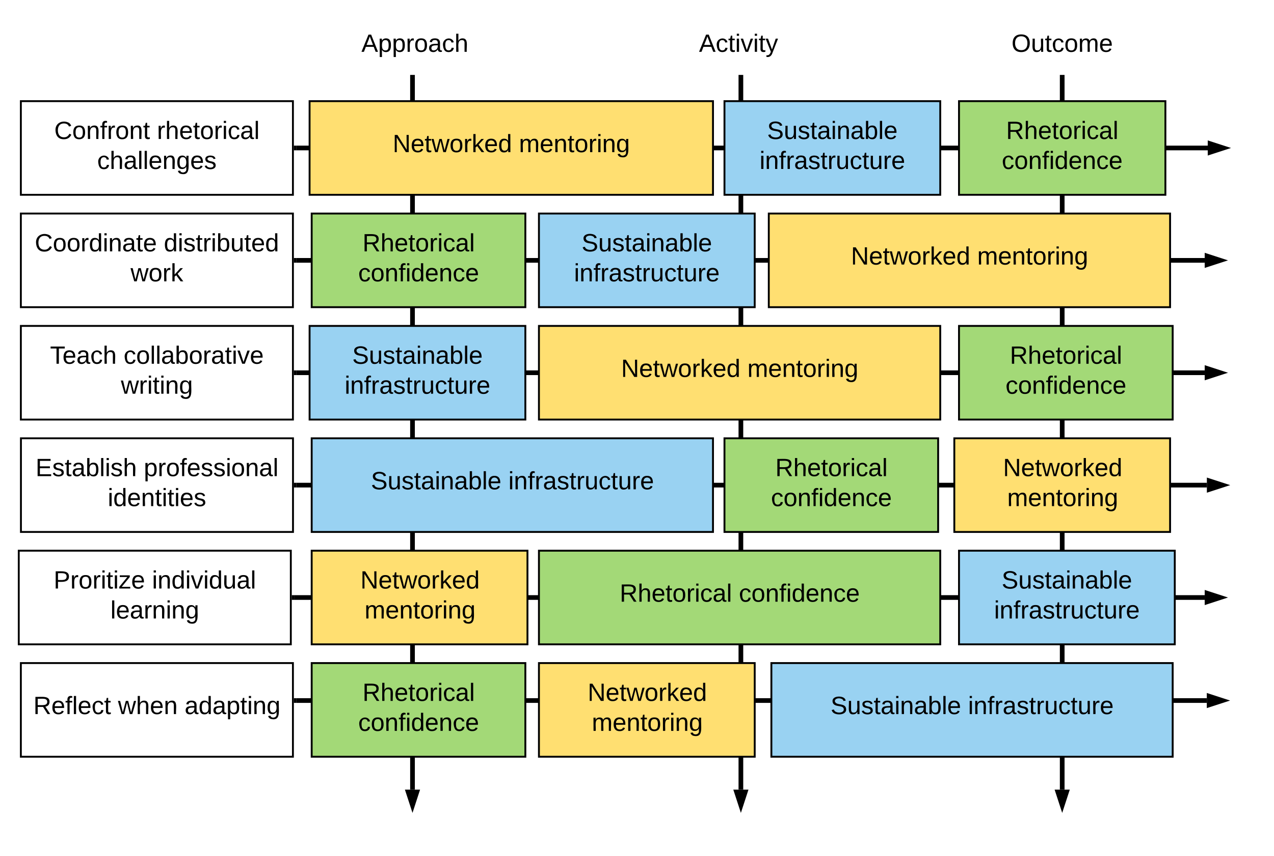
Introduction to the Constructive Distributes Work (CDW) Heuristic
Notes:
Constructive Distributed Work (CDW) is a three dimensional heuristic for team building, mentoring and project management. It shapes how we work together as a team. Assessing how we are enacting the three dimensions of the heuristic informs our user-centered approach to iterating on current practices to better support our project goals and our researchers. The study we are presenting today focuses on the “orientations to work” dimension of the heuristic.

Slide 4
Understanding orientations to work
Activity— Process or task focused. Doing the “everyday work” of Crow research
Approach— The theory and purpose that underpins *how* we work
Outcomes— Evidence of achieving core principles and furthering project goals.
When writing and teaching about CDW we find that the distinction between activity and approach are sometimes difficult to explain. Clearer distinctions and definitions for how we recognize these elements are necessary for assessment and for building more generalizable tools for research teams.
Notes:
In CDW, we see there being three orientations to work. Activities are process or task focused, the “everyday work” that we do at Crow. Approaches are the theories and purposes that underpin how we work. And Outcomes are those finalized elements that serve as evidence that we’re achieving our core principles and furthering the project. Distinguishing and defining these elemtns are necessary for assessment and for building more generalizable tools for research teams.

Slide 5
For example: Approach, activity, or outcome?
This kind of interaction is a typical one that occurs on Basecamp (our team communication platform):
Undergraduate researcher #1: I have finished my first environmental scan linked here. Can @UG researcher #2 do a secondary review of it?
Undergraduate researcher #2: I did a secondary review, and I think we can improve our template to make it less bulky. @Faculty PI can you review our scans and my changes to the template?
Faculty PI: @UG researcher #2, great suggestions! Finish your scans using your new template then you and @UG researcher #1 can compare to the older version and see which we like better, then update. 😊
Notes:
The interaction written out here is typical of everyday work on Crow projects, and on it’s surface demonstrates how we use Basecamp (our team communication platform) to coordinate work, but can we identify evidence of our orientations to work in interactions like this?

Slide 6
Current research questions
What assessment methods help us to identify orientations to work in the individual records of team communication on Basecamp?
How does identifying these aspects of Crow work help us to better articulate approach, activity and outcome?
How can this assessment support iterative changes to Crow practices?
How can this analysis help us to develop more generalized CDW tools that could help other organizations and research teams?
Notes:
The article we are currently completing will address all four of these RQs. In this presentation we are sharing results from the first 2.

Slide 7
RQ#1: What assessment methods help us to identify orientations to work in the individual records of team communication on Basecamp?
Collaborate on and test a coding schema building from pilot data (Weech et al. 2022)
Identify a diverse set of threads (purposes) with records from diverse kinds of researchers
Split utterances using a set of rules to divide longer records.
Develop individual and collaborative coding process building on workflow developed in previous holistic coding of the same data set (Buwick & Islas 2024)
Notes:
Our first Research Question asks what assessment methods help us identify orientations to work in the individual records of team communications. To do this, we tested a coding schema built from pilot data, identified a set of communication threads in Basecamp with records from diverse kinds of researchers, split those utterances up to help enable our coding, and developed individual and collaborative coding processes building on workflow developed in previous holistic coding of the same data set (and please check out the work of Crow researchers Sarah Buwick and Naomi Islas, who did so much with this work. Their poster is presented in the Student Research Competition).

Slide 8
Methods: data set used for this analysis
We identified six threads from different project areas (development, presentations & publications, prototyping).
Threads included researchers from multiple positions in our team (undergraduate, graduate, early career faculty, faculty PIs)
Records from the six threads were split into 163 utterances for individual and collaborative coding.
Notes:
For this analysis, we identified six threads in Basecamp from different project areas. Those threads included researchers from multiple positions on our team. And we split those threads into 163 utterances that we could code individually and collaboratively.

Slide 9
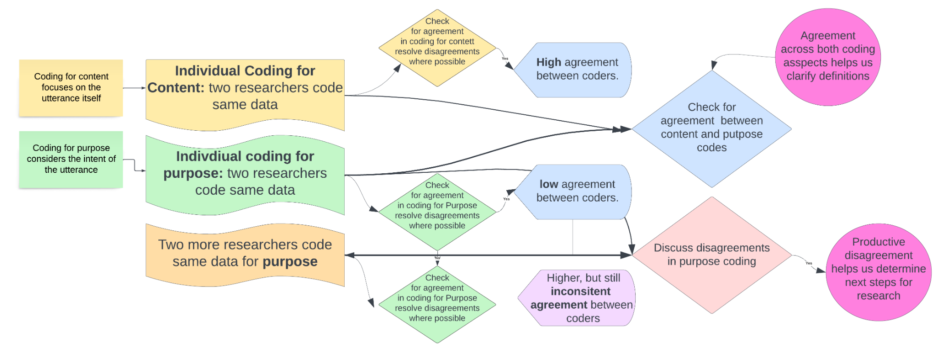
Collaborative coding process diagram
Notes:
This diagram illustrates the reflexive and collaborative nature of our coding process which included researchers with varying levels of Crow background and expertise. Full agreement across codes was not the intention of this collaboration. Because we were both testing methods, and looking for focus points for further research.

Slide 10
Graduate researcher insights on collaborative coding methods
Individual Coding:
Keeping the individual coding individual
Individual coding presented us with feedback that helped in refining the coding scheme and improving the definitions of the thematic codes.
Guiding questions for writing an analytical memo
Example: Are there any specific instances or decisions that you think we should look at more closely?
Coding for “purpose” and “content”
Possible dual functions for “boosts” – fit with both “activity” and “approach”
Be on the same page before proceeding to collaborative coding
Notes:
Wei Xu: As the two coders from the University of Arizona, both of us participated in individual coding and collaborative coding. During the individual coding process, each of us needed to resist the temptation to look at other coders’ coding results to ensure that we may use our unique angle to make coding decisions, and that each of us can contribute our unique institutional and professional knowledge. At the end of individual coding, we found the guiding questions for us to write an analytical memo of particular help. For example, I identified that one of my confusions lied in understanding the coding for “content” and “purpose” even though I read the coding guide multiple times. Also, in response to the guiding question of “Are there any specific instances or decisions that you think we should look at more closely?” I stated that I found it tricky to code “boosts” as sometimes their functions can be ambiguous, because some of them seem fit with both “activity” and “approach.” The questions that we compiled in the round of individual coding sparked productive discussion in our follow-up synchronous meetings and prepared us for being on the same page in collaborative coding.

Slide 11
Graduate researcher insights on collaborative coding methods
Collaborative Coding:
The positionalities we took in collaborative coding
Our goal ≠ complete consensus
Our goal = the potential of our disagreements
Productive disagreements: Further insights
Example: coders' background knowledge of the Crow team
Notes:
Dilara Avci: What stood out to me most in this study was our positionalities that we took as a team in collaborative coding. Unlike the common instinctive practice/purpose of dissolving disagreements through discussions, the goal of our collaborative coding was not to come to a complete consensus. Rather, we sincerely articulated our coding process and aimed to understand what made each of us choose a code over another and how the codebook guided our decisions. It was through those discussions that we came to realize the potential of our disagreements and differences for some codes. For example, one of the main factors in coding an interaction differently turned out to be related to the coder’s background knowledge of the Crow team and its members such as PIs and graduate students, and level of engagement with Crow practices, and disciplinary affiliation (applied linguistics, technical communication, writing studies). This approach led to fruitful discussions and further insights into what was happening in the Crow practices and the potential need for further data sources such as discourse-based interviews.

Slide 12
RQ#2: How does identifying these aspects of Crow work help us to better articulate approach, activity, and outcome?
Notes:
Our second research question asks how identifying these aspects of Crow work can help us to better articulate our orientations work: approaches, activities and outcomes.

Slide 13
What we found: Agreement
Coding for Content (i.e. what we actually see in the utterances)
57% agreement from individual coding
77% agreement after collaborative coding
Activities
Again: these are utterances that coordinate work, assign tasks, direct researchers to materials, align schedules, etc. “Getting stuff done”
The most common utterances (89 from individual coding, 90 after collaboration) are activities.
Example: “I haven’t had a chance to get to this yet, but I will work on it tonight!”
Notes:
Among our results, we most often found agreement when coding for content. In other words, we were coding recordings in Basecamp based on what we actually saw happening in the utterances (versus what we thought the purpose of the utterance was). We saw a greater agreement here both individually and collaboratively.
The most common utterances, and the ones we generally agreed on the most–were Activities. These are recordings that coordinate work, assign tasks, direct researchers to materials, align schedules, and so forth. In other words, this is language used to “get stuff done.” For example, here we have a post by a Crow researcher describing her intent to work one evening on an ongoing part of the project.

Slide 14
What we found: productive disagreements
Coding for Purpose (i.e. what the goal or intention of the post is)
Only 29% agreement after individual coding
Approach, Activity, or Outcome?
Approaches are utterances that demonstrate, focus on, or make explicit the theory and expertise that underpins Crow’s best practices or core principles.
Our discussions solidified differences between the three.
Based on our discussions, we clarified what it means to be an “Approach”: more focused on why something is happening than the actual something happening
In other words, if the Activity is the thing that happens, the Approach is what guides that activity as it happens.
Example: The Scheduling Thread
“Let’s go with 3:00pm MDT. Thanks, everybody!”
Researcher contextuality
Notes:
We also coded for purpose. In other words, we looked at what the GOAL of each post was. Interestingly, we had more disagreement here: only about a third of the time did our individual coding align. While this improved during collaborative coding, it also led to productive discussions that gave us insight into what we were seeing in the data.
Much of our discussion was around the differences between Approaches, Activities, and Outcomes. Looking at Approaches, specifically: these are utterances that demonstrate or make explicit the theory and expertise that underpins Crow’s best practices or core principles. In other words, these are posts that are more focused on WHY something is happening. They are the posts that GUIDE the action.
An example: one thread that we looked at was a long thread (more than 20 posts over the course of 2 days) in which Crow researchers were scheduling a meeting. By the strictest definition, these posts would be Activities and not Approaches, but there was one post toward the end of the thread in which one of Crow’s PIs stepped in to finalize the scheduling, as shown in the example. Yes, the schedule was finalized, but the language that the PI used–”let’s go with”--suggested a nuance and subtlety that was aiming for more than just scheduling the meeting. This single post was an example of an Approach instead of an Activity because the researcher’s purpose was to schedule the meeting while at the same time mentoring early-career and graduate researchers about Crow best practices.
Interestingly, one of the reasons we had disagreement here was that two of the researchers doing the coding remembered this thread, while the rest of us weren’t with Crow at the time. Those of us who weren’t with Crow didn’t have the contextual knowledge to know that what the PI did was mentoring, but the old-timers remembered the situation well and had the contextual knowledge to recognize the approach at work.

Slide 15
Clearer definitions for orientations to work
Activity: Records that coordinate work, assign tasks, align schedules, direct researchers to materials.
Approach: Records that make explicit the theory or expertise that underpins work. The “why” or “how” of the utterance is more important than the “what” of the record.
Outcome: Records that denote completion/achievement of project or goal
Notes:
An important distinction came through in our coding discussion. While on one level we could code nearly every utterance as an “activity” because we are always getting things done, we could agree that in some instances even seemingly mundane utterances that moved work forward could be coded as “approaches” rather than activities. This helps us see how we make those distinctions in our internal practices, and can help us to clarify examples and build exercises to help onboard new researchers, as well as develop tools for helping other researchers make these distinctions in their own workflows.

Slide 16
Next Steps:
Code the same data set for two other dimensions of the heuristic: Best practices and core principles.
Conduct discourse-based interviews
Notes:
Moving forward, coding for the other two dimensions of our three-dimensional heuristic will help us triangulate data and resolve disagreements and questions that arose in coding orientations to work. The CDW heuristic is designed to take a three-dimensional perspective. Attention to all dimensions will help us better assess our own practices, identify areas for improvement, and develop tools to help others apply CDW in their own teams.
This analysis identified specific records in Basecamp that will also guide discourse-based interviews. For example, our productive disagreement about whether “Approach” is being demonstrated by records of everyday work can initiate discussion with researchers themselves about their thinking processes when coordinating work on Basecamp.

Slide 17
Learn more about Constructive Distributed Work
McMullin, M. & Dilger, B. (2021). Constructive Distributed Work: An integrated approach to sustainable collaboration and research for distributed teams. Journal of Business and Technical Communication, 35 (4), 469-495.
Weech, S., Banat, H., McMullin, M., Swatek, A, Gupta, A., and Dilger, B. (2022). “Assessing Equity and Inclusion in Research Teams through Constructive Distributed Work.” In 2022 IEEE International Professional Communication Conference (ProComm), 65-71.
McMullin, M., Banat, H., Weech, S., & Dilger, B. (2022). “Building Ethical Distributed Teams Through Sustained Attention to Infrastructure.” Communication Design Quarterly, 10(2), 32-43.
And stop by the Student Research Competition to chat with more Crowbirds:
Buwick, S. & Islas, N. (2024). Using collaborative coding to study how research teams coordinate work.
Visit Writecrow.org/cdw/ for more information and to access tools created by the CDW team.
Notes:
Thanks for listening. For more information about CDW and Crow, check out the above, and stop by the SRC to chat with more Crowbirds!

